Slide 1
Recipe Ideas
Bolognese Sauce with Pasta
Butter Biscuits
Frozen Fruit Smoothies
Ham, Mustard and Cheese Toastie
Vegetable and Halloumi kebabs

Slide 2
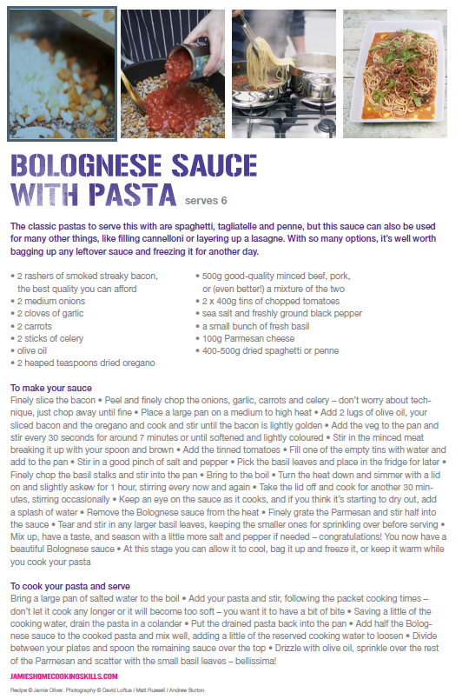
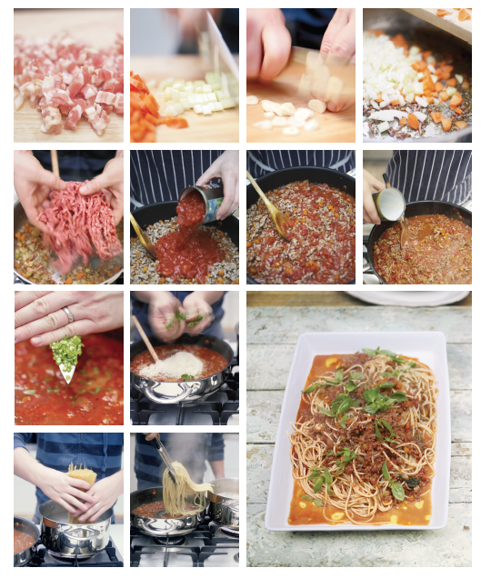

Slide 3

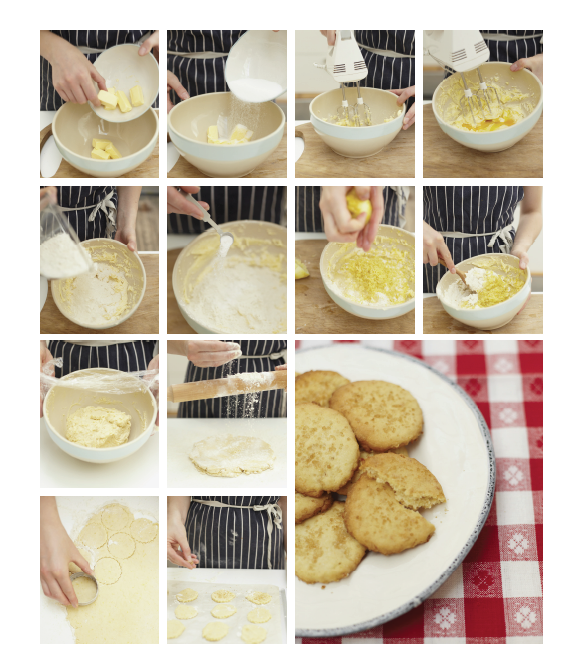

Slide 4
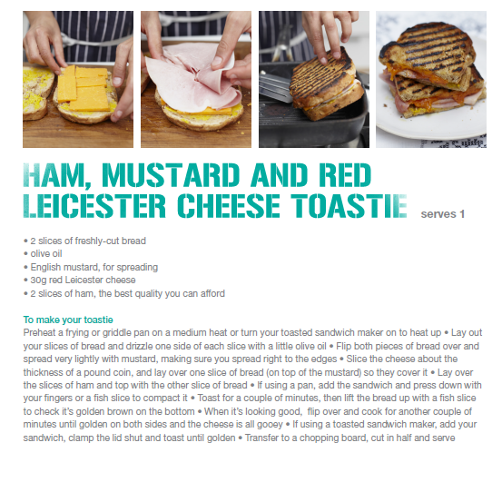
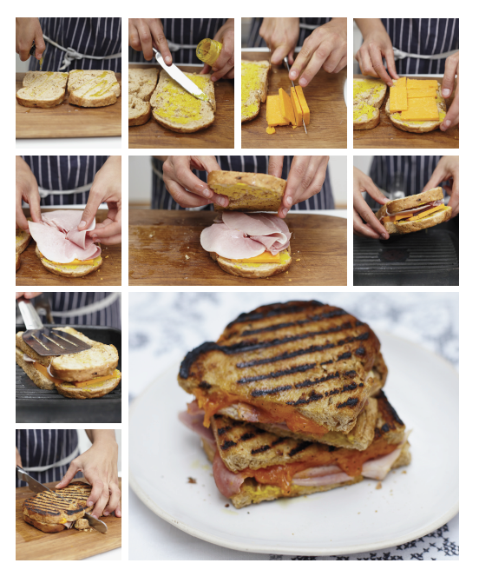

Slide 5
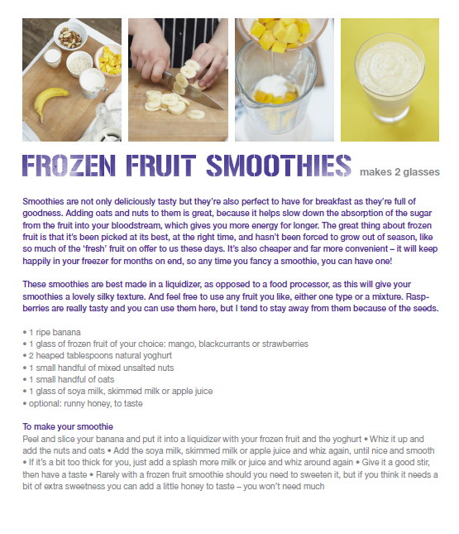
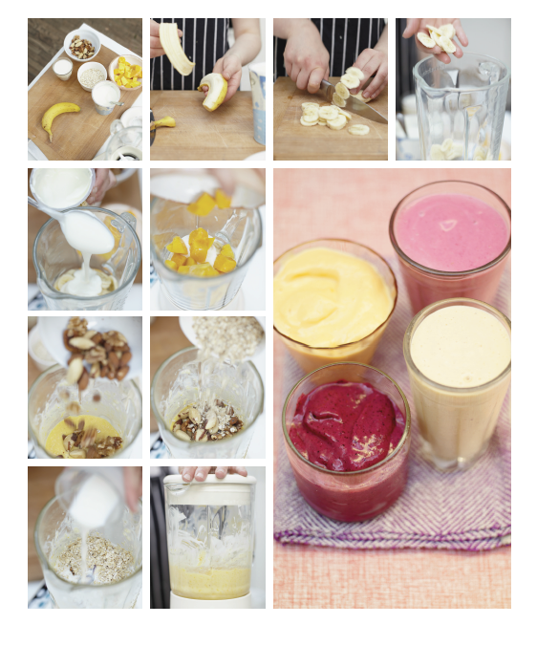

Slide 6
